Slide 1

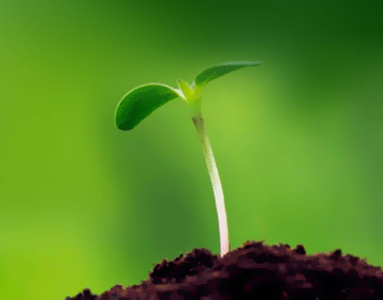
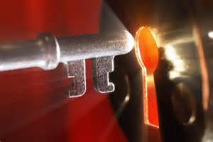
Six Secrets
of the
Christian Life

Slide 2
Introduction

Slide 3
Question ?
How does the Christian live the Christian life?

Slide 4
Answer
Working Hard
Will Power
Dedication
Total Surrender

Slide 5
The Problem
The Christians inhabits a spiritually dead body

Slide 6
The Problem
Romans 8:10-11

Slide 7
The Problem
“If Christ is in you, the body is dead because of sin,..” (Romans 8:10a)

Slide 8
The Problem
“If you have believed in Christ, then Christ is now living in you, even though your physical body is dead spiritually because of sin, (Romans 8:10a)

Slide 9
The Problem
Believe

Slide 10
The Problem
Believe
Eternal Life
Christ in you
New Life

Slide 11
The Problem
Believe
Eternal Life
Christ in you
New Life
Dead Body

Slide 12
The Problem
Believe
Inward Being
or Nature
Changes
Physical Body Remains
the Same

Slide 13
The Problem
Believe
New Life
Dead Body
No Effect
Completely Unresponsive

Slide 14
The Problem
Desires Good
Wages War
New Life
Dead Body
No Effect
Completely Unresponsive

Slide 15
The Problem
“the willing is present in me, but the doing of the good is not.” (Romans 7:18b)

Slide 16
The Problem
“For I delight in the law of God according to the inward man. But I see another law in my members, warring against the law of my mind, and bringing me into captivity to the law of sin which is in my members.” (Romans 7:22)

Slide 17
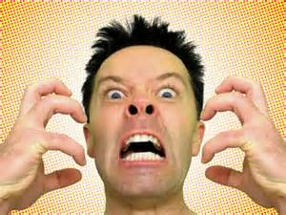
The Problem
“O wretched man that I am! Who will deliver me from this body of death?” (Romans 7:24)

Slide 18
The Problem
Believe
New Life
Frustration
Our Effort

Slide 19
The Solution
“but the Spirit is life because of righteousness.” (Romans 8:10b)

Slide 20
The Solution
Everyone who believes possess the Spirit
“Now if anyone does not have the Spirit of Christ, he is not His.” (Romans 8:9b)

Slide 21
The Solution
Believe
New Life
Dead Body
Righteousness
His Spirit

Slide 22
The Solution
“But if the Spirit of Him who raised Jesus from the dead dwells in you, He who raised Christ from the dead will also give life to your mortal bodies through His Spirit who dwells in you.’ (Romans 7:11)

Slide 23
The Solution
Believe
New Life
Dead Body
Righteousness
His Spirit
Life

Slide 24
The Christian Life
Human Effort
Supernatural Work

Slide 25
Secret #1
The Miracle
of Resurrection

Slide 26
The Solution
Believe
New Life
Dead Body
Righteousness
His Spirit
How?
Life

Slide 27
The Solution
2 Corinthians 3:18

Slide 28
The Solution
“But we all, with unveiled face, beholding as in a mirror the glory of the Lord, are being transformed into the same image from glory to glory, just as from the Lord, the Spirit.” (2 Corinthians 3:18)

Slide 29
The Solution
His Spirit
Dead Body
By His Power
Transformation

Slide 30
The Solution
His Spirit
Come Alive
By His Power
Process
Transformation

Slide 31
The Solution
Transformation Process
“When we all, with unveiled face, see in a mirror the glory of the Lord,” (3:18a)

Slide 32

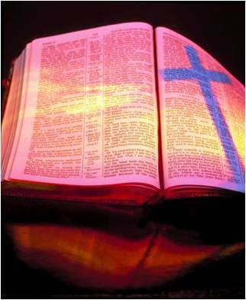
The Solution
Transformation Process

Slide 33
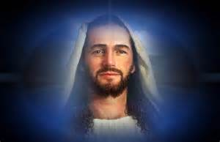
The Solution
Transformation Process

Slide 34
The Solution
The Scriptures
“these Scriptures… are they which testify of Me” (John 5:39)

Slide 35
The Solution
The Scriptures
“beginning with Moses and all the prophets he explained to them all the Scriptures the things concerning Himself” (Luke 24:37)

Slide 36
The Solution
Transformation Process

Slide 37
The Solution
Transformation Process
“When we all, with unveiled face, see in a mirror the glory of the Lord,”

Slide 38
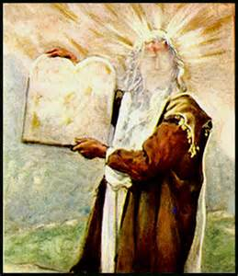
The Solution
Our Unveiled Face
Exodus 34:29-35

Slide 39
The Solution
Our Unveiled Face
A Complete Openness and Exposure to the Word and the Lord of Glory.

Slide 40
The Solution
Veiled Face
Unbelief
Israel’s mind were blinded; a veil remains unlifted in the reading of the Old Testament” (2 Corinthians 3:13-16)

Slide 41
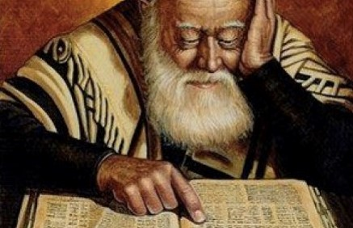
The Solution
Veiled Face
Unbelief

Slide 42
The Solution
Veil Removed
Faith

Slide 43

The Solution
Our Unveiled Face
Continuous Faith

Slide 44
The Solution
Our Unveiled Face
“the life which I now live in the flesh I live by faith in the Son of God,” (Galatians 2:20)

Slide 45
The Solution
Continuous Faith
Dead Body
His Power
Transformation
Process

Slide 46
The Solution
Continuous Faith
Life
His Power
Transformation
Process

Slide 47
The Solution
Transformation Process
“are being transformed into the same image from glory to glory, (3:18b)

Slide 48
The Solution
Transformation Process
Not Immediate
Not Automatic
Can be Regressive

Slide 49
The Solution
Transformation Process
From one stage of transformation to another
“from glory to glory”

Slide 50
The Solution
Transformation Process
Goal is increasing conformity to the likeness of God’s Son Jesus Christ

Slide 51
The Solution
Transformation Process
“just as by the Spirit of the Lord.” (3:18c)

Slide 52
The Solution
Continuous Faith
Life
His Power
Transformation
Process

Slide 53
Secret #2
The Miracle
of Transformation

